Slide 1
Table and Graphs

Slide 2
Dynamic Pasting
Row Labels | Sum of Land area (sq miles)
Brooklyn | 70.82
Manhattan | 22.83
Queens | 108.53
Staten Island | 58.37
The Bronx | 42.1
Grand Total | 302.65

Slide 3
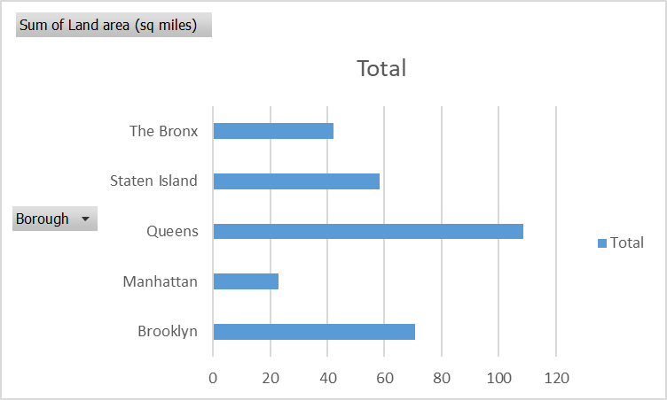
Static Pasting

